Slide 1
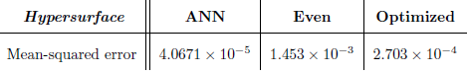
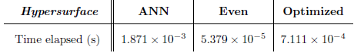
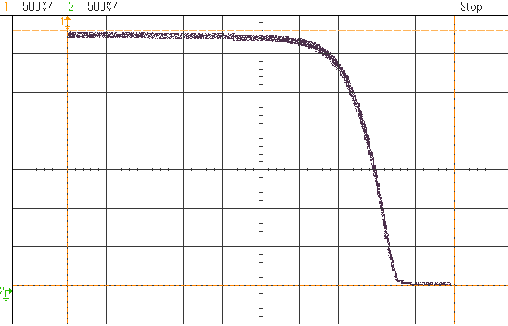
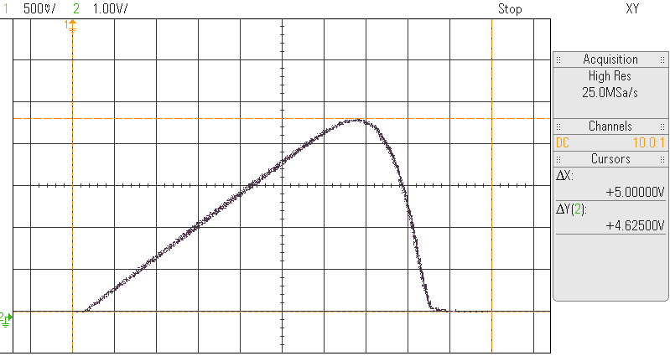
Piece-wise hypersurface simplification of mapped n-dimensional
artificial intelligent systems
Abgeiba Y. Isunza Navarro, Kennet García Oviedo / A01215412, A01215390 / ITS, ITS
SUPERVISORS: Dr. Luis Ibarra Moyers, MSc. David Balderas Silva
REVIEWERS: Dr. Pedro Ponce Cruz, Dr. Hiram Ponce Espinosa
April, 2017
1. Introduction
The complexity of Artificial Intelligence (AI) present a bottleneck in computational processing, and often limits the actual implementation in hardware. As a result, fitting an AI algorithm often requires a huge amount of hardware resources or approximations methods, so a tradeoff between accuracy and devices’ cost appear. The solar Photovoltaic (PV) energy sector is a clear example where the development of low cost, reliable and energy efficient systems is needed in order to continue its growth. In that regard, this work presents an implementation of the PLMI [1] technique in order to run a neural model of a PV panel on a low-cost microcontroller, boosting the execution time without compromising the accuracy of the system.
2. Objectives
4. Implementation
5. Results
To implement a PV neural model in an 8-bit low-cost microcontroller using the PLMI method, in order to confirm PLMI viability in terms of processing time and memory usage. Additionally, precision loss is to be tested against the original AI model based on their mean square error (MSE).
Graphically represent and quantify the number and distribution of PLMI bars.
To quantify the four possible meshing techniques in terms of execution time, memory usage, and approximation error.
Develop a C generic library to run PLMI.
The neural model of a PV cell was obtained and approximated in order to be implemented in a 8-bit low-cost microcontroller.
The even approximation, demonstrated to be 13 times faster than the optimized approximation, and 35 times faster that ANN model.
Table 1: Comparison between the theoretical model and the approximated models over 1000 random samples.
Figure 2: Schematic diagram of the approximation process of a PV module.
Table 2: Averaged execution time of the three test devices.
The PLMI technique was implemented in a sequential structure since it is targeted to a conventional hardware device.
Comparing the scaled and unscaled versions, the even approximation presents an error increment of 15.08% with a execution acceleration of 2.7 times, while the optimized approximation an error increment of 23.25%.
3. Methodology
Based on a black-box model that represents any system whose input-output relation can be modeled with a static n-dimensional linear hypersurface. There are two main stages:
Optimized approximation using a Genetic Algorithm (GA): The optimal quantity and distribution of the grid-lines is determined by a GA according to the specific characteristics of the hypersurfaces (HS).
Figure 3: Block diagram of the PLMI technique.
Figure 5: Characteristic curves of the PV module running in the MCU.
A comparison was done in terms of memory use, processing time, and MSE between the Neural Network (NN), even, and optimized HS using the Matlab/Simulink platform.
Target hardware device is an 8-bit low cost microcontroller. Four scenarios were tested, varying the numeric representation of the stored data and the approximation type.
6. Conclusion
A neural model of a PV module was successfully implemented in a 8-bit low-cost microcontroller using the PLMI method.
A reduction in execution time was achieved, 35 times for an even mesh, and 13 times for an optimized mesh compared with the neural system.
A C generic library was implemented for the PLMI method.
7. Future work
Figure 1: a) Even mesh, b) optimized mesh.
Apply the PLMI technique for different AI systems, such as Fuzzy Logic Controllers for Maximum Power Point Tracking (MPPT) in PV modules.
Parallel Linear Mesh Interpolation (PLMI): This method approximates the values that were not sampled (out of the grid joints) by comparing the point of interest with its surrounding grid-lines and neighbors.
Figure 4: Block diagram of the hardware implementation.
[1] Research Project from the National Graduate School ITESM, Mexico City Campus

